Slide 1
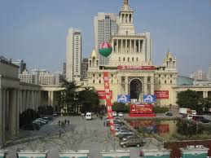
ICCCN 2014 Panel #1
Cyber-Physical Clouds – Risks and Opportunities
Moderated by:
Krishna Kant, Temple University
kkant@temple.edu
August 4, 13:30 - 15:00

Slide 2
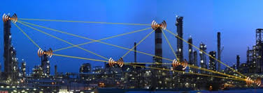
Cyber-Physical Clouds Risks and Opportunities
Panelists:
Dr. Jun Wang, Univ. of Central Florida
Dr. Haibo Chen, Shanghai Jiaotong Univ
Dr. Baek-Young Choi, Univ of Missouri at Kansas City

Slide 3
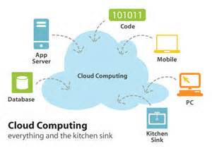
Panel Logistics
Introduction and Remarks
Krishna (~15 mins)
Position Statements by Panelists
15 mins each approx, max 45 minutes
Open Discussion (~30 mins)

Slide 4
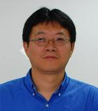
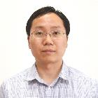
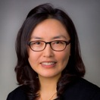
Panelists
Dr. Jun Wang joined Department of Electrical Engineering and Computer Science in University of Central Florida in 2006. Recently, he has won 2013 Dean’s Research Professorship Award, Charles N. Millican Faculty Fellow 2010-2012, and University of Central Florida Research Incentive Award 2010.
Haibo Chen is a full professor in School of Software, Shanghai Jiao Tong University. His research interests are system virtualization and systems software. He received the 2011 Distinguished Ph.D thesis award from China Ministry of Education.
Dr. Baek-Young Choi is an Associate Professor in the Department of Computer Science and Electrical Engineering at the University of Missouri - Kansas City. Her research interests lie in the broad area of algorithm and system development for diverse types of networks, especially in resource management and network monitoring.

Slide 5
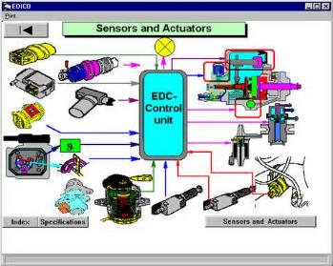
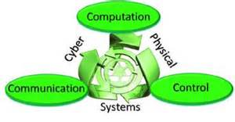
Cyber-physical Systems
Increasingly sophisticated cyber control of physical systems
Predictive and Situation aware
Able to work in uncertain or changing environments
Cognizant of human needs & behavior but tolerant of their mistakes

Slide 6
Cyber-Physical Clouds
What is it (other than hype)?
Offloading part of the “cyber” to clouds
Utilizing cloud concepts in CPS
Outsourcing (use of public clouds)
Virtualization of sensors and actuators
Agile resource shifting and sharing
Pay as you go model for CPS?

Slide 7
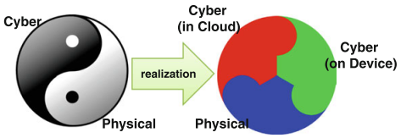
Offloading cyber
Partitioning cyber between device & cloud
What, where, how, and why?
S. Karnouskos, A.W. Colombo & T. Bangemann, Trends and Challenges for Cloud-Based Industrial Cyber-Physical Systems, Book: Industrial cloud-based CPS, Springer 2012

Slide 8
Offloading Scenarios
Non-control path operations
Statistics & trends, discovery & maintenance, etc.
Offline or long-term adaptation and optimization
Easy to offload & scale w/ cloud
Low-freq analytics/control
Detect developing anomalies, hot spots, reconnaissance, …
Dynamic adaptation/optimization
Offloading “safe” if cloud reachability is ensured.
Avg loading & pwr quality (on cloud)
SCADA (local)
Power Grid
Freq/phase oscillations & stats (on cloud)
PMU data collection & synch (local)
Power Grid

Slide 9
Offloading Scenarios
Real-time control
Wide area state estimation & devising suitable control action
Risky, could be exploited by attackers
Securing may introduce SCADA delays
Transmission line sync + (on cloud)
PMU data collection (local)
Power Grid
All control (on cloud)
Direct interface to sensor data stream
Perhaps sensible for complex sensing at moderate data rates.
PMU data as a service (local)
Power Grid

Slide 10
Key questions: offloading
Where should the boundary lie?
How do app. characteristics play into this?
Could the partitioning be situation aware (e.g., dynamically changing)?
Where do you make the determination?
Low freq analytics & control
Low freq analytics & control
Real-time analytics
Statistics & mgmt
Real-time analytics
Statistics & mgmt
Sensor data processing
Sensor data processing
Physical
Physical

Slide 11
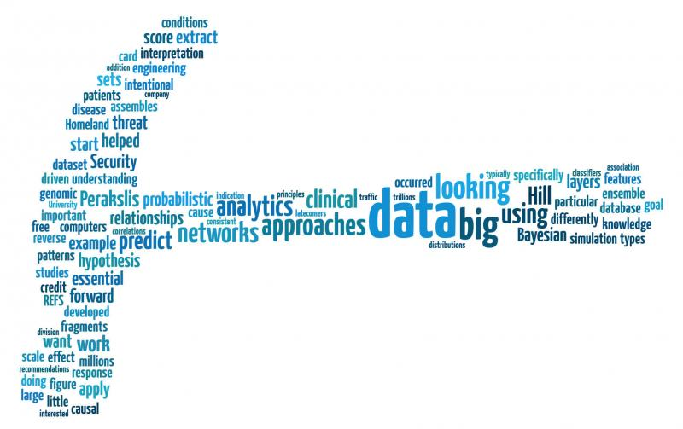
Key questions: offloading
Why and how?
Does offloading enhance capabilities, performance, and robustness of CPS?
What are the security risks and can they be managed?
How do you manage impact of additional delays on SCADA performance?

Slide 12
Key questions: cloudy cps
To outsource or not?
Private Cloud: Does it make sense?
Public (or 3rd party) clouds:
Usual issues of trust and risk of targeted attacks.
Virtualization of sensors and actuators
Sensors and actuators as a service
What are the compelling use cases?
Agile resource shifting and sharing
Can they support QoS needs of multiple apps?
Differentiated services

Slide 13
Questions to Panelists
Is cyber-physical cloud another hype?
Is there a common architecture for exploiting cloud computing for a diverse set of cyber-physical systems?
What is the suitable division of cyber between local system and cloud?
Does cloud paradigm enhance resilience of CPS systems?
What new security risks does the cloud paradigm introduce for CPS and can they be managed?

Slide 14
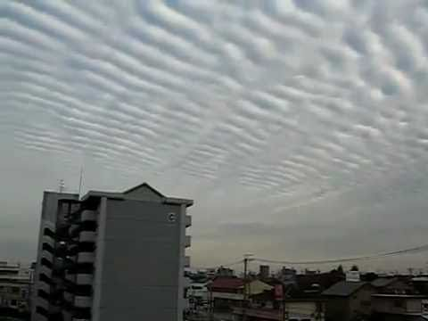
Thank you!

Slide 15
Thank you

