Slide 1


Scaling up Performance and Scaling out Storage for Cyber Physical System: Research and Opportunities
ICCCN14 CPS Cloud Panel
Jun Wang
University of Central Florida, Orlando
Notes:
In this talk, I will present our …

Slide 2
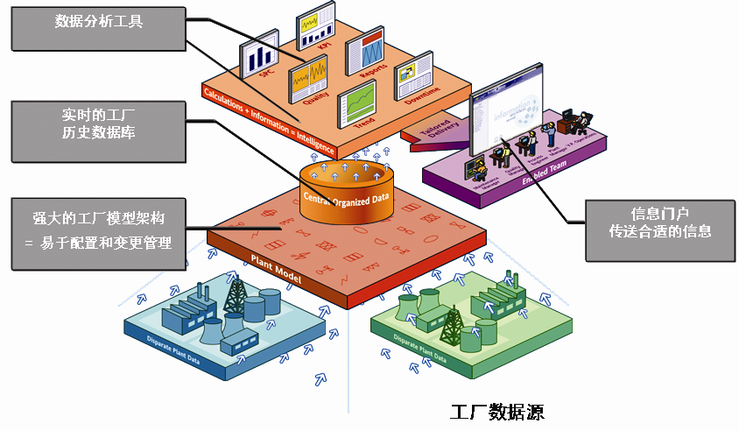
A sample small-scale CPS system:
Energy management cloud system by Shenzhen KINGSINE ELECTRIC AUTOMATION CO., LTD.
Analysis
Tools
系统结构图
Realtime
DB
Model
Interface
Data end users
Data sources

Slide 3
系统总体设计
Energy Monitor,
Management,
And Analysis
通讯网络结构
Energy Data Center
Onsite Data Sampling
Data Collector Server
LAN
Wireless
Communication
Switches
Smart
Power
Meters

Slide 4
Motivation
What is needed, therefore, are software
and hardware infrastructures that can support the needs of next-generation large-scale CPS. These new large-scale CPS require high QoS fidelity and a high degree of asset sharing,
and must support a large number of system components.

Slide 5
Challenges
Workloads:
  It is hard to predict the exact load because CPS are influenced by a wide array of physical
  phenomena for which science has not developed accurate or fast predictive models.
  Different datasets exhibit distinct characteristics (such as the data from traffic, power grid fluctuations, human movement, and changing weather patterns )

Slide 6
Limitations of current cloud solutions:
Existing cloud computing techniques cannot be directly applied to CPS. Flexibility in cloud is orthogonal to real-time QoS needs.
Auto-scaling elastic compute and storage needs to take different datasets own characteristics into consideration
Virtualization techniques are not helpful in a real-time QoS system
  Delay and jitter
MapReduce and Hadoop are offline solutions by default

Slide 7
Opportunities
Perform In-situ data processing in original data collector(s)
  Data are too heavy to move
  Many raw data are useless, do not need to be saved permanently, and transferred to the cloud server
  Preprocess raw data locally to extract useful information, such as traffic surveillance video or security monitor data.

Slide 8
Opportunities – cont…
Consolidate all of available smart resources near emergency area and constitute an ad-hoc regional cloud and storage infrastructure
  Handle spiky traffic near emergency areas
  This may be feasible as smart buildings, smart vehicles and smart phones could be quickly organized by some unified mechanisms, protocol, interfaces and contribute their computing and storage to enable an in-situ data processing

Slide 9
Opportunities – cont…
MapReduce and Hadoop are in-appropriate to perform real-time analytics and interactive visualization.
  A potential candidate will be a Spark framework developed by Berkeley AMP lab
  Spark Streaming is designed with the goal of providing near real time processing with approximately one second latency to such programs. It enables in-memory analytics.
  Some of the most commonly used applications include web site statistics/analytics, intrusion detection systems, and spam filters.

Slide 10
Opportunities – cont…
Spark Streaming seeks to support these queries while maintaining fault tolerance similar to batch systems that can recover from both outright failures and stragglers
Spark Streaming allows high-throughput, fault-tolerant stream processing of live data streams
More ideal features:
  Alternative machine learning algorithms, distributed block management and memory management

Slide 11
Opportunities – cont…
Scalable data locality-aware scheduling

Slide 12
Data Locality-aware Scheduling
  Collecting the information of data distribution associating with compute nodes.
  Computing proper tasks for parallel processes such that they can achieve maximum degree of data locality computation.
  Sending tasks assignment to parallel processes.
Notes:
We propose a scalabel locality-aware middleware for these scientific application. Our SLAM will allow these applications to benefit the locality computation with the use of HDFS.

Slide 13
Long Latency Scheduling Problem for Interactive Application
Scheduling a task usually causes hundreds of milliseconds of latency
  needs to know the local data on the compute node.
  tens of workers issue task requests simultaneously.
  these requests are handled sequentially.
However, for interactive data processing like in a real-time QoS context, a job should be finished in second
  Interactive gene search, visualization, log analysis/ error detection
Notes:
This is the workflow of scheduling, to assign a task to a worker, the scheduler usually needs to collect the locality metadata. And the idle message from workers are put into a message Q. With the problem size becoming larger, such a scheduling delay is unaccepteable for interactive data processing.

Slide 14
A Scalable Scheduling Architecture
We develop a Scalable Scheduling Architecture for Interactive Analysis Programs, which could be potentially applied to CPS Cloud
  Multiple schedulers: keep track of data processing tasks.
  Each worker process: use a novel Modulo-based priority method to schedule its own local tasks (as long as local data exists).
Notes:
We present a Scalable scheduling to solve the scheduling delay problems.

Slide 15
Interactive workflow between workers and schedulers
If there are unprocessed tasks with local data on the worker hard drive, the worker tries to decide a local task for itself.
  The worker process selects a candidate task using the Modulo-based priority method and sends a local task execution request to a proper scheduler.
  The scheduler replies with an approval message to the worker.
  The worker decodes the reply message and either executes the approved task or tries to schedule some different task if the request is not approved.
Notes:
In our ScalScheduling architecuture, we use multiple schedulers to track the data processing tasks. And we allow each worker to use a modulo-based priority method to schedule its local tasks.

Slide 16
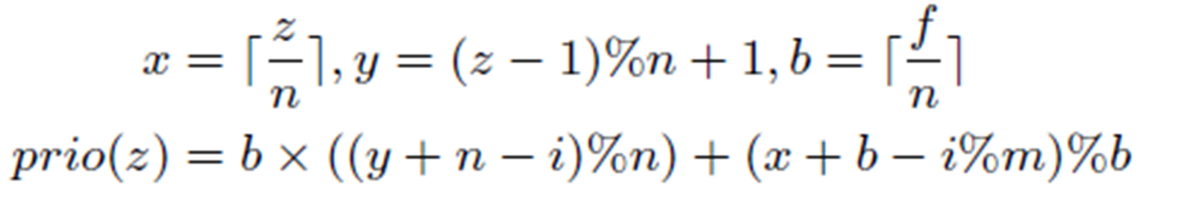
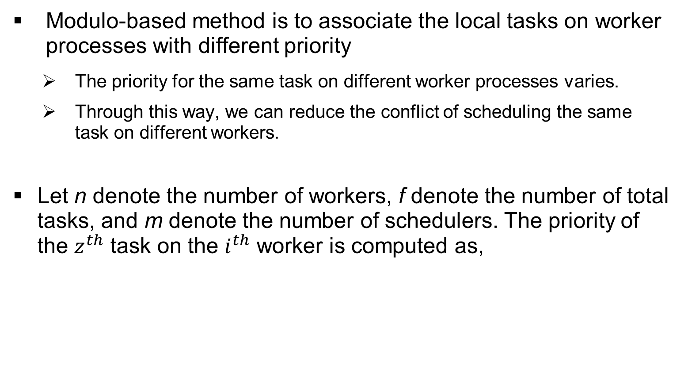
Modulo-based method for Self-scheduling
Modulo-based method is to associate the local tasks on worker processes with different priority
  The priority for the same task on different worker processes varies.
  Through this way, we can reduce the conflict of scheduling the same task on different workers.
Let n denote the number of workers, f denote the number of total tasks, and m denote the number of schedulers. The priority of the task on the worker is computed as,
Notes:
Modulo-based method is to associate the local tasks on each worker with different priority, calculated based on the information of task, worker and scheduler processes.
The priority for the same task on different workers varies. Through this way, we can reduce the conflict of execution requests on the same task from different workers.
For instance, the task on the right has higher priority; s1 and s2 are the two schedulers each controlling 6 tasks.

Slide 17
Interactive workflow between schedulers and workers
If there are no remaining local tasks, the worker enters the remote execution mode
  The worker sends a remote task assignment request to a scheduler, which is chosen using a probabilistic decision based on the number of unassigned tasks controlled by each scheduler.
  The scheduler schedules a task for the worker by considering the system load balance and sends an assignment message to the worker.
  The worker receives the message and executes a assigned remote task, or sends another remote task request to a different scheduler.
Notes:
In our ScalScheduling architecuture, we use multiple schedulers to track the data processing tasks. And we allow each worker to use a modulo-based priority method to schedule its local tasks.

Slide 18
Experimental Setup
Platform: 128 nodes / 256 cores, dual 1.6GHz AMD Opteron processors, 16GB of memory, Gigabit Ethernet, and a 2TB Western Digital SATA disk drive.
Linux version: CENTOS55-64 with kernel 2.6.
Co-located storage: Hadoop distributed file system
Parallel programming model: MPICH [1.4.1]
Notes:
In our test, we select ‘nt’database, which have the size of 45 GB. The network file system used for comparison is PVFS and NFS. The distributed file system is Hadoop file system.

Slide 19
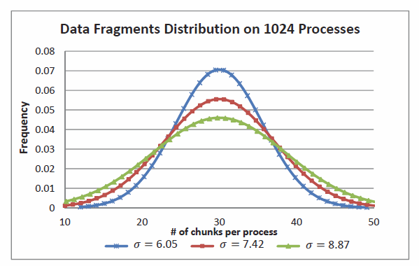
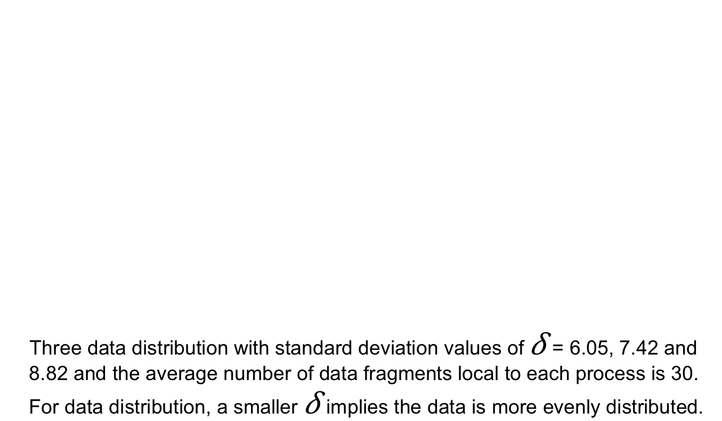
Locality testing (data distribution)
Three data distribution with standard deviation values of = 6.05, 7.42 and 8.82 and the average number of data fragments local to each process is 30. For data distribution, a smaller implies the data is more evenly distributed.

Slide 20
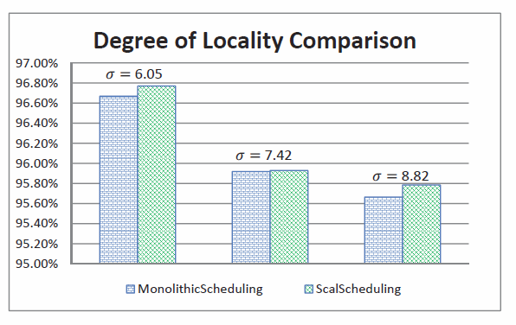
Degree of Locality Comparison
In all three cases, ScalScheduling achieved slightly higher degrees of data locality computation in all three cases.

Slide 21
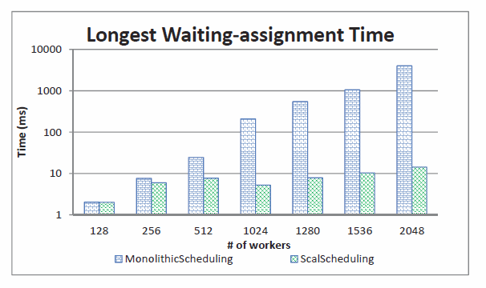
Longest Waiting-Assignment
In general, as the longest wait time increases, so does the parallel execution time. The figure shows that for MonolithicScheduling the longest waiting-assignment time greatly grows with the increasing number of processes.

Slide 22
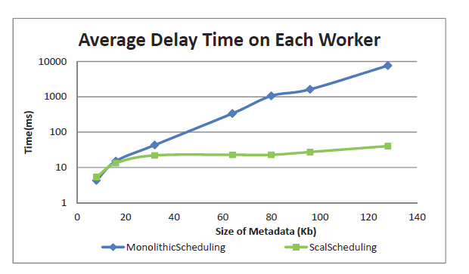
Average Delay Time Comparison
Much shorter delay times for ScalScheduling than Monolithic Scheduling when the size of data locality information reaches 40KB (data to be processed tasks are around 300GB).
Size of data locality information(kb)

Slide 23
Thank you!

