Slide 1
Cyber-Physical Cloud(y) Computing: Good News, Bad News and Looking Forward
Haibo Chen

Slide 2
What is CPCC?
A cloudy definition by NIST of US
“a system environment that can rapidly build, modify and provision cyber-physical systems composed of a set of cloud computing based sensor, processing, control, and data services”
-- A Vision of Cyber Physical Cloud Computing for Smart Networked Systems, NIST Interagency/Internal Report (NISTIR) – 7951
CPCC, another buzzy word? a hype or a virtue?
Notes:
This a really cloudy definition, no clear boundary, though not really a hype.
We need a clear, doable definition.

Slide 3
A Picture on CPCC
Source: Kyoung-sook Kim, JPGrid/Workshop38

Slide 4
Good News of CPCC

Slide 5
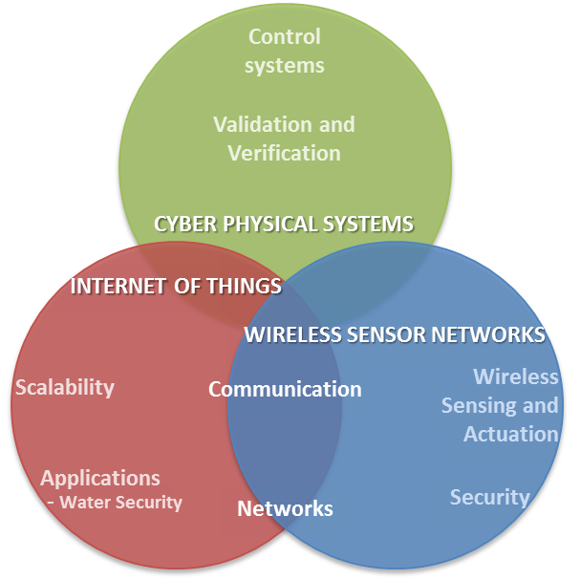
Cloud-assisted Smarter Physical Wolds
A good example of win-win situation with feedback loops
Cloud has abundant resources, essentially breaks resource scarcity of physical worlds
Physical worlds help design better
cloud, provide better services

Slide 6
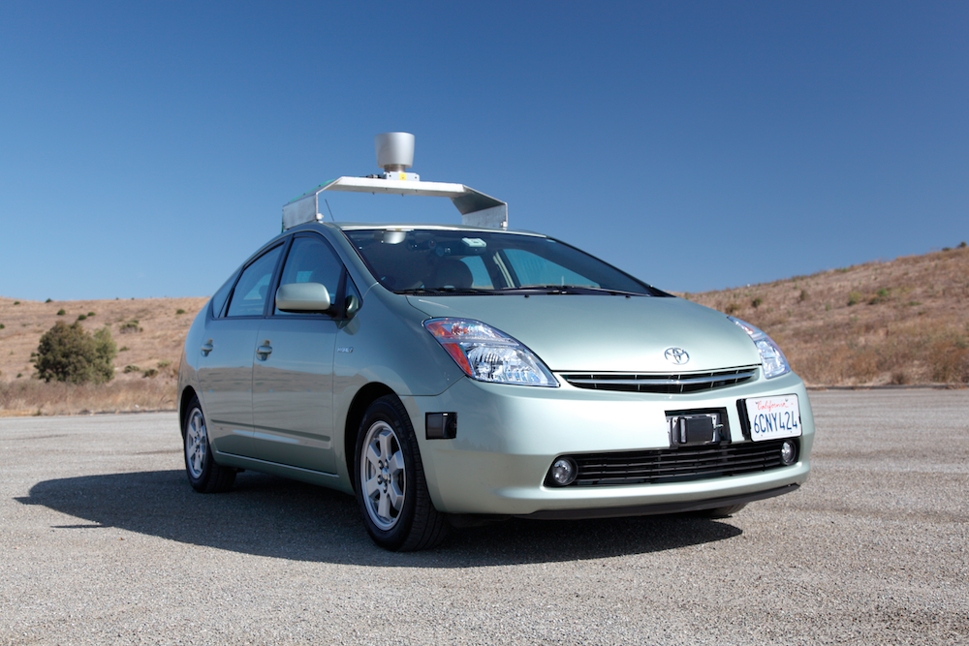
Google Driverless Card
Notes:
This is an example of cloud helps physical world
The car then takes these generated maps and combines them with high-resolution maps of the world, producing different types of data models that allow it to drive itself.
Currently (as of June 2014), the system works with a very high definition inch-precision map of the area the vehicle is expected to use, including how high the traffic lights are; in addition to on-board systems, some computation is performed on remote computer farms

Slide 7
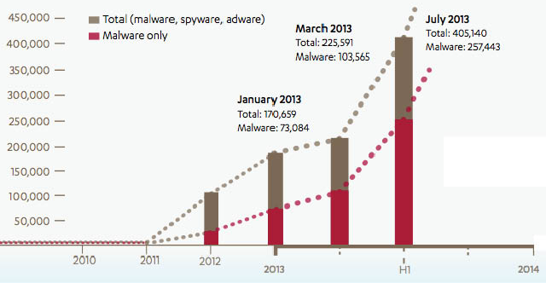
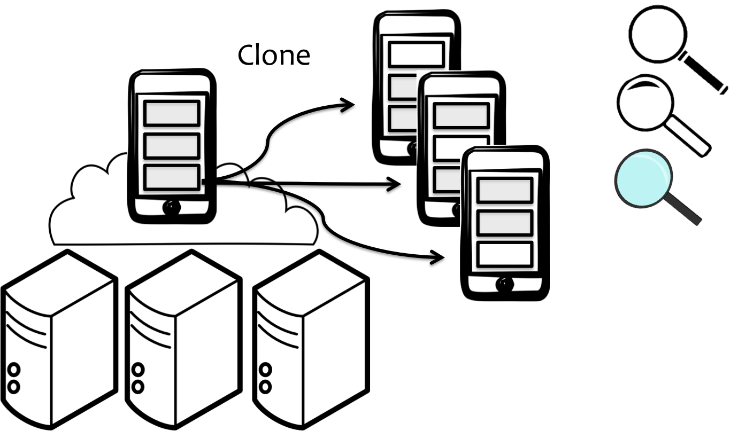
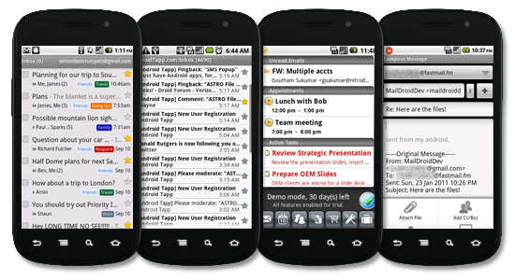
PreCrime (APSys 2014)
Offload the detection phase to cloud
Reduce performance overhead
Flexibly adding /adjusting detecting policy
Speculative execution one step ahead
Prevent malicious behavior from happening
Mitigate state explosion problem
Notes:
An example of leveraging abundant resources of cloud.

Slide 8
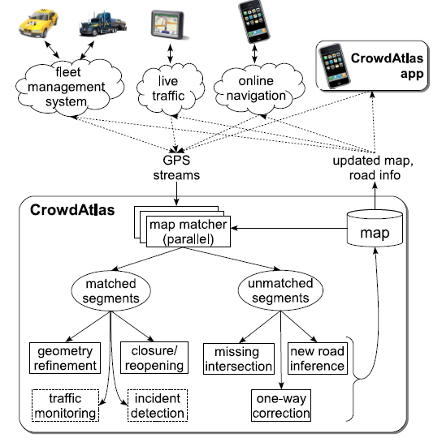
CrowdAtlas (Mobisys’13, Wang et al.)
Problem: Inaccuracy of manually created digital road maps
Solution: CrowdAtlas, which automates map update based on people's travels (individually or crowdsourced)
Using mobile navigation app detects significant portions of GPS traces that do not conform to the existing map
http://grid.sjtu.edu.cn/mapupdate/
Notes:
From my colleagues, an example how physical world helps cloud.

Slide 9
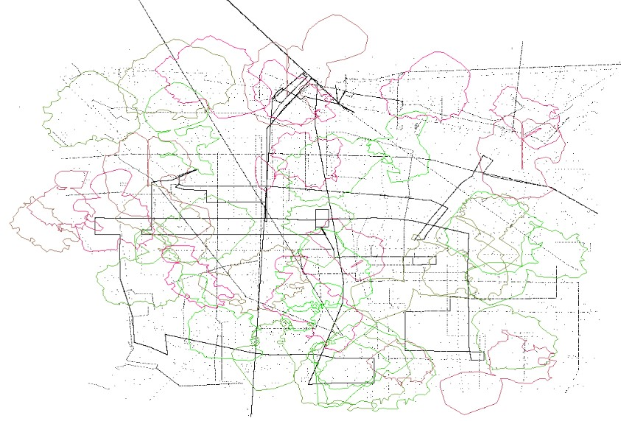
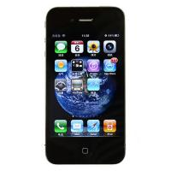
GeoFence (ACM SIGSPATIAL GIS Cup’13)
Geo-fencing
Advertisements
Children location services
…
From xxx
Sales!
Notes:
An example of how physical world helps cloud and cloud helps back.
This problem is about geo-fencing, which is a virtual perimeter for a real-world geographic areas. It’s a very hot topic and can be used in advertisements, children location services and so on.
When the location-aware device of a location-based service (LBS) user enters or exits a geo-fence, the device receives a generated notification. This notification might contain information about the location of the device. The geofence notice might be sent to a mobile telephone or an email account.
Geofencing, used with child location services, can notify parents if a child leaves a designated area
LBS 2.0 -地理柵欄
地理柵欄(geofence)最大的特色是「主動推播」。
柵欄的概念如同字面，是由地圖上的虛擬標記點所劃分出來的區域。我們可以利用某間餐廳、某地標，甚至是直接利用座標，來訂出柵欄標記，圍出一個虛擬區域(可能是我家巷口麵店到學校這塊，也可能是整個台北市)。程式會於背景不斷運算、反饋用戶的地理位置，一旦用戶進入或離開了「柵欄區域」，就可以主動發出各種形式的通知 (SMS：小明安全地到學校了！)。

Slide 10
Bad News of CPCC

Slide 11
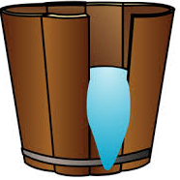
Cyber Systems Meet Physical Worlds
Unique Feature of Cyber Systems
Remember “Worse is better design” slogan in computer systems design-Richard P. Gabriel
Design systems almost work!
“Unix and C are the ultimate computer viruses.”
Traditional Physical systems
Small, fixed functionality
Carefully designed, modeled and/or verified
Buckets effect of security
Low security/reliability guarantees
Cloud?
Notes:
the worse-is-better software first will gain acceptance, second will condition its users to expect less, and third will be improved to a point that is almost the right thing.

Slide 12
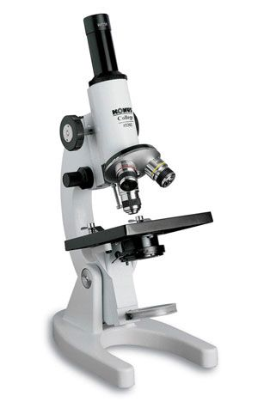
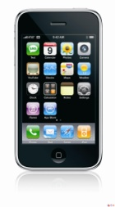
Can we believe in cloud?
Inside Threats to
Cloud Services
“invisibly access unencrypted data in its facility”- Gartner, 2008
Name: Haibo
Salary: 100$
Creditcard: 8621 4579
…
Name: Haibo
Salary: 100$
Creditcard: 8621 4579
…
Internet
Haibo
Control
VM
Control
VM
VM
(with private data)
Modified VM
VMM
VMM
(malicious)
Results
Storage
Is a rich guy?
NO!
YES!
Yes!
Cloud
Notes:
Hey Alice, put your creditcard number, ssn and emails with your boyfriends to my cloud
Believe in me, I promise to keep it secure

Slide 13
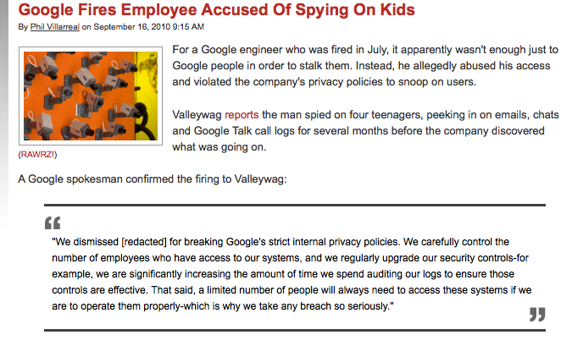
Reason#1: curious or malicious operators
..., peeking in on emails, chats and Google Talk call logs for several months …

Slide 14
Reason#2: huge TCB for cloud
4.0
Control VM
Tools
Guest
VM
3.0
2.0
Kernel
VMM
Trusted Computing Base
The TCB is growing to 9 Million LOCs by 2011
One point of penetration leads to full compromise
37 security issues are found in Xen and 53 in VMWare by Oct 2010. [CVE’12]
The virtualization stack should be untrusted

Slide 15
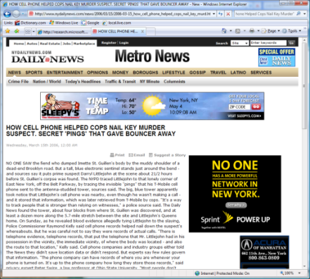
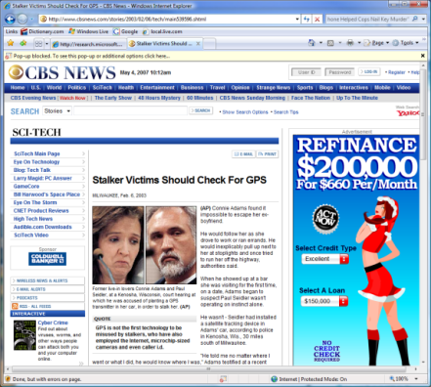
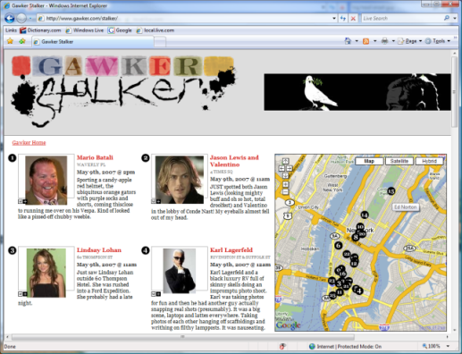
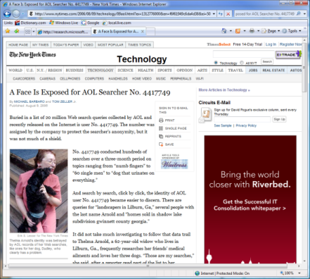
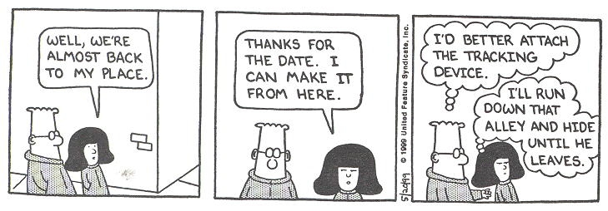
Location Privacy Leaks
How Cell Phone Helped Cops Nail Key Murder Suspect – Secret “Pings” that Gave Bouncer Away
New York, NY, March 15, 2006
Stalker Victims Should Check For GPS Milwaukee, WI, February 6, 2003
Real time celebrity sightings
http://www.gawker.com/stalker/
A Face Is Exposed for AOL Searcher No. 4417749
New York, NY, August 9, 2006
Notes:
Stalker: 暗恋/追星族
The AOL search data leak was the release of detailed search logs by AOL of a large number of AOL users. The release was intentional and intended for research purposes; however, the public release meant that the entire Internet could see the results, rather than a select number of academics. AOL did not redact any information, causing privacy concerns since users could potentially be identified by their searches.
Allew: 公园小径

Slide 16
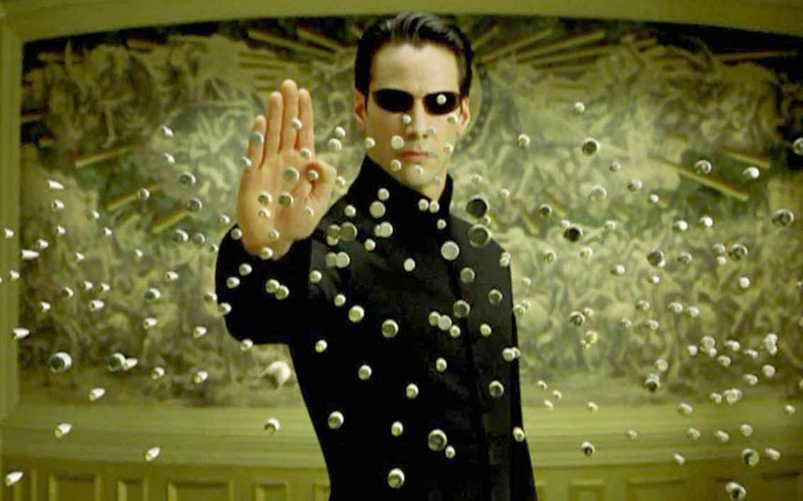
The Matrix Reloaded
Image source: http://nextviewventures.com
Notes:
Cyber world controls physical world? We all live in cloud?

Slide 17
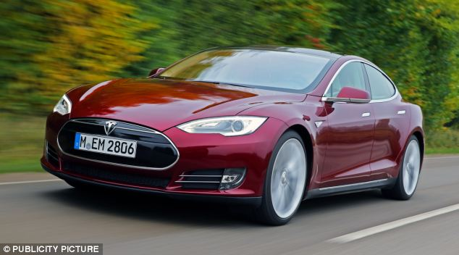
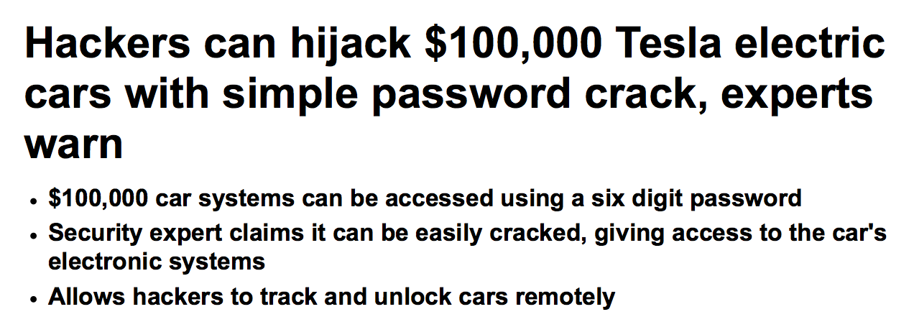
Security

Slide 18
Look forward?
Notes:
Look forward? The good news is that we have a number of problems to work on, and we all will have a good job☺

Slide 19
Building Dependable CPCC
Formal/code verification
e.g., seL4: https://github.com/seL4
Well-defined boundary between cyber/physical worlds
Building trusted systems from untrusted (cloud) services
Fault Resistant
Fault containment
Redundancy

Slide 20
More Seamless Cyber/Physical Cloud
How to seamless and cooperatively build both cyber and physical systems?
New program models is needed!
New systems software foundation
e.g., HomeOS (NDSI’14),
Building Operating System Services (NSDI’13)
Tools for support building cyber/physical cloud

Slide 21
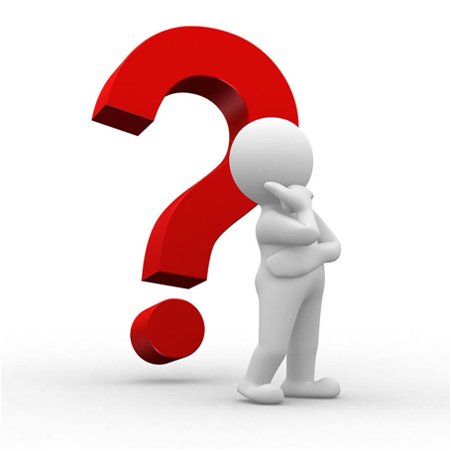
Thanks
Questions
CyberPhysical
Cloud(y) Computing
Institute of Parallel and Distributed Systems
http://ipads.se.sjtu.edu.cn

