Slide 1
Wireless Multimedia Networking
- Device-to-Device (D2D) Video Delivery
8/1/2011
C.-C. Jay Kuo
University of Southern California

Slide 2
Wireless Video: Key Challenge in the Next Decade
Expected wireless traffic will increase by 65 times from 2009 to 2014
  Cisco Visual Networking Index
Most traffic (~66%) will be video services
  Streaming TV, Internet video, video on demand
  Video sharing, video conferencing, live video broadcasting
  Video twitter, video blogging
  Ubiquitous access from multiple platforms
  e.g. TVs, PCs, mobile devices, and embedded devices

Slide 3
How to Address the Challenge?
Incremental modification
  Enhanced physical layer -> MIMO-OFDM
  Improved video processing -> next slide
  How much we may gain? around 10-15 more
Fundamental breakthrough yet with a proper migration path
  An effort being explored by a joint USC team sponsored by Intel, Cisco and Verizon
    G. Caire, A. Dimakis, J. Kuo, A. Molisch, M. Neely and A. Ortega

Slide 4
Improved Video Processing
Pre-processing
  Automatic identification of region of interests (ROIs)
  Rate control
Post-processing
  Super-resolution
  Frame-rate up-sampling
  Error concealment
  Denoising
Novel video coding
  Scalable video (H.264, H.264/SVC)
  New standardization effort (HEVC)
  Scalable extension of HEVC
Perceptual-based video coding
  A reduced reference approach

Slide 5
Basic Idea to Fundamental Breakthrough
Communication bottleneck occurs in the last wireless hop
  Between mobile devices and BS/AP
Can we allow direct communication between devices: device-to-device (D2D) streaming
  Existence of interesting contents of neighboring devices (with 1-hope distance)
  Semi-central delivery control
    Separation of signaling/control signals and video contents

Slide 6
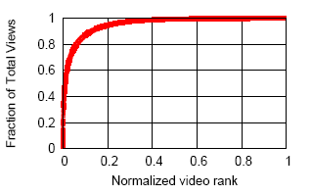
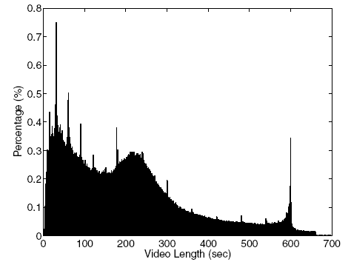
Redundancy of Popular Video
YouTube video popularity follow two rules
  Highly skewed video popularity distribution (top 10% videos have 90% of total views)
  ‘Rich gets richer’ – popular video likely continues to be popular in the future
Popular video categories and length
  Music, Entertainment, Comedy, Sports are most popular categories
  Most of them are short video clips (less than 5 minutes)
Can we exploit the above statistics?
Sports (10%), Comedy (12%)
Entertainment (18%)
Music (23%)
Statistics of YouTube video popularity
* Siddharth Mitra ,“Characterising Online Video Sharing and its Dynamics” , M.Tech thesis, IIT Delhi, July 2009
* Xu Cheng, et al., “Statistics and Social Network of YouTube Videos”, Proc. of IEEE IWQoS, 2008
Notes:
Left figure shows that nearly top 10% of the videos (in our dataset) have 90% of the total number of views (highly skewed). Smaller Normalized rank implies most popular video.
Right figure plots the distribution of YouTube video lengths within 700 seconds (~99%), which exhibits three main peaks. The first peak is within one minute, containing more than ~22% of the videos implying YouTube is primarily a site for very short videos. The second peak is between 3 and 4 minutes, containing about ~23% of the videos; this peak is mainly caused by the large number of videos in the “Music” category, since “Music” is the most popular category, and the typical length of a “Music” video is often within this range(3-4 mins). The third peak is near 10 minutes; it is caused by the limit on the uploading video length, which encourages some users to circumvent the length restriction by dividing long videos into several parts, each being near the limit of 10 minutes.“Entertainment” videos (18%) have the greatest peak at around 10 minutes compared to other categories, probably because most of these videos are talk shows, movies, or sitcoms. Probably corresponding to “highlight” type clips, “Comedy” and “Sports” videos have more videos within two minutes. We can also observe that there are peaks at around every exact minute.

Slide 7
Semi-Central Delivery Control
BS/AP
Signaling messages
Signaling messages
Device #1
Device #2
Video content delivery

Slide 8
Rationale of D2D Design
Issues with pure P2P
  Highly distributed but at the cost of efficiency
  Difficulty in DRM
Advantages with D2D
  Leverage the existing infra-structure (BS/AP)
  Content management (registration/search)
  Rights management
  Keeping 1-hop wireless link

Slide 9
Future R&D Opportunities & Directions
Exploit video popularity
  Social networks
Make scalable video practical
  Lot of R&D activities
  Not popular in practice, why?
Local storage
  Femtocell networks at home or office
  Storage in mobile devices
  Storage schemes
Spatial re-use
  Interference mitigation
  Throughput optimization
Digital rights management (DRM)

