Slide 1


Dynamic Spectrum Management
A path to ubiquitous 100+ Mbps DSL Service
ICCCN 2011
August 1, 2011
Maui, Hawaii
John M. Cioffi
Chairman and CEO, ASSIA Inc.
Prof Emeritus, Stanford U
ASSIA: G. Ginis, W. Rhee, B. Lee, C. Chen, M. Mohseni, W. Lee,
Stanford: A. Chowdhery, H. Zou, H. Mehmood, and M. Chen

Slide 2
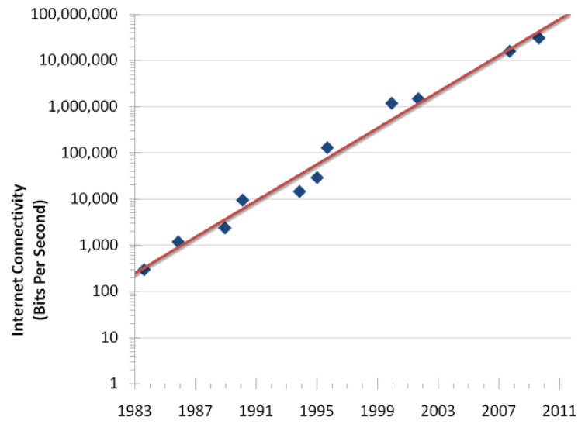
Internet Access Bandwidth Growth
Source: J. Nielson
useit.com
50% growth per year – high-end users
Suggests 100 – 200 Mbps access desirable in 2015

Slide 3
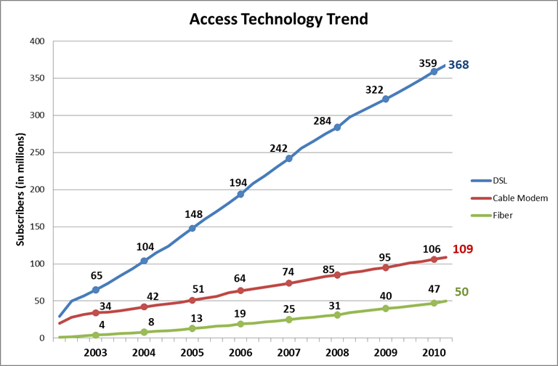
Global Broadband Access
600M in 2015
DSL is largest fraction (over 70% of broadband)
  And growing faster, still gaining
  It costs a lot less

Slide 4
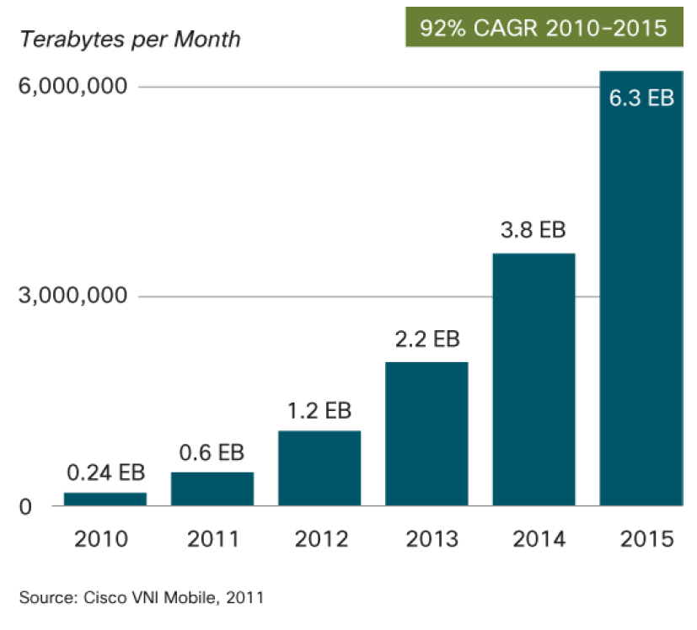
Mobile Data ( Cell + Wi-Fi ) Growth
Offloaded Data over Wi-Fi
x26 Growth factor !!
2.46 EB
74.4 PB

Slide 5
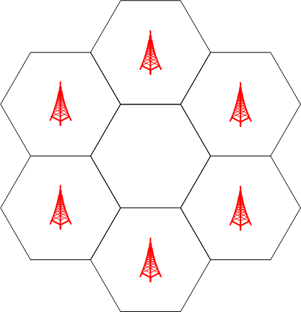
Wireless Multiplier:
Evolution to Smaller Cells
Increase capacity 2-10x
  More subscribers
  More “smart phones”
Solution:
  Smaller cells
DSL connection to small cell
Wifi or femto
Notes:
Cell splitting
Add new base stations at places with heavy traffic load
Cell topology shall be irregular
Voice, text -> media
Cellphone -> smart phone, i-phone, g-phone -> netbook/notebook

Slide 6
Service Providers are Aggressively Deploying IPTV
CAGR = 92%

Slide 7




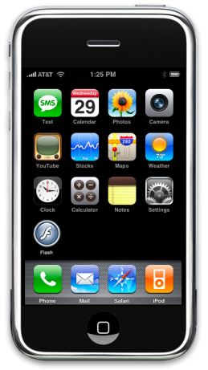
Video Quality (IPTV, tablet, smartphone)
Transmission Source
Consumer
Tablet
IPTV
Multiplexer/Streamer
>90% of problems originate here
Core Network
CPE
DSLAM/RT

Slide 8
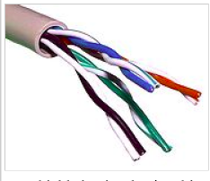
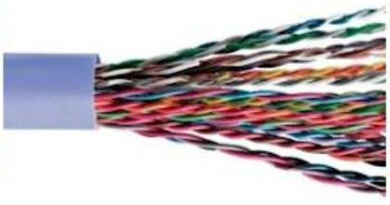
How Fast is Copper?
10 Gbase-T is 2.5 Gbps/pair
  at 100m on category 6 twisted pair
150Mbps – 500Mbps DSLs demonstrated
  100m on category 3 twisted pair
100Mbps to 1 Gbps DSLs?
  Dynamic Spectrum Management (DSM)

Slide 9


DSM: Managing Copper is Key
DSM Level 1: external noises vary with time
In-home Interference
DSM Level 2: crosstalk among unvectored pairs
DSM Level 3: crosstalk among vectored pairs
ASSIA
DSLAM
Crosstalk
Core Network
fiber
Copper Impairments
Results:
- higher speeds
- improved stability
- longer loops
- reduced costs
Radio Interference

Slide 10
DSL (with DSM) Rate Reach Steps
Mbps
Range-Planning Tool
  Can use fiber to shorten copper (VDSL)
2:1 Asymmetry ratio (Down/Up) on speeds above 20 Mbps

Slide 11
3 Standardized DSM Levels
DSM Level | First Availability | Speeds (Mbps) | Description
1 | 2007 | < 25-50 | Function: Single-line Data and Single-Line Control Goal: Line Stability: reduce retrains and packet errors Standard: ITU – G.997.1, G.992.1,5 (ADSL1, ADSL2+, VDSL2)
2 | 2010 | <100 | Function: Multiline Data Collect, Single-Line Control Goal: Power control and savings Standard: ITU – G.997.1, G.992.1,5 (ADSL1, ADSL2+, VDSL2)
3 | 2013 | 100+ | Function: Multiline Data and Control (VECTORED) Goal: Cancel Noises and Crosstalk (100+ Mbps) Standard: ITU, G.vector (G.993.5)

Slide 12
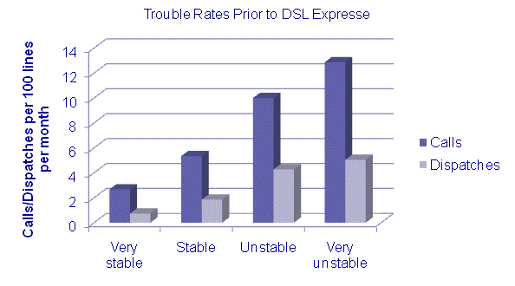
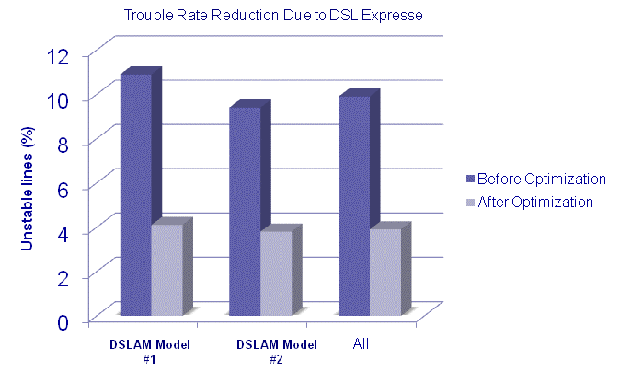
Level 1 = Stabilization
Most networks see 30-60% reduction in unstable lines
Example from US DSL operators (30M on DSM)
  Call, dispatch rates closely correlated to DSL stability
  Level 1 DSM reduces unstable lines by 60%

Slide 13
Speed Increase - Europe
Stability Before TRA
Stability After TRA
Dnstrm Rates Before TRA
Dnstrm Rates After TRA
8%
5%
1%
3%
14%
13%
3%
19%
13%
40%
11%
29%
24%
16%
61%
47%
29%
19%
23%
21%
Above 14.5Mbps
CV<=50 and Retrain<=0
12~14Mbps
CV<=250 and Retrain<=1
10~12Mbps
CV<=1000 and Retrain<=2
7~10Mbps
CV<=5000 and Retrain<=3
5.7~7Mbps
Others
Below 5.7Mbps

Slide 14
Rate and Loop Length Extension European Example
Distance at which 50% of the lines can support 6 Mbps increased to 2500m. Previously, no distance existed for 50% coverage at 6 Mbps
Distance at which 50% of the lines can support 2 Mbps increases from 2200m to 3200m or 45%
At 3000m, fraction of lines that can support 2 Mbps increases from 33% to 52% or a 58% increase
At 2500m, fraction of lines that can support 6 Mbps increases from 25% to 52% or a 108% increase
At 1500m, fraction of lines that can support 10 Mbps increases from 18% to 42% or a 133% increase

Slide 15
South America

Slide 16
South America
36% Reduction

Slide 17
Chinese Results (customers)
Success rate calculated on 24 hour period
reprofiling normally done daily to avoid variability
Initial optimization period
Maintenance optimizations

Slide 18
DSM Levels
DSM Level | First Availability | Speeds (Mbps) | Description
1 | 2007 | < 25-50 | Function: Single-line Data and Single-Line Control Goal: Line Stability: reduce retrains and packet errors Standard: ITU – G.997.1, G.992.1,5 (ADSL1, ADSL2+, VDSL2)
2 | 2010 | <100 | Function: Multiline Data Collect, Single-Line Control Goal: Power control and savings Standard: ITU – G.997.1, G.992.1,5 (ADSL1, ADSL2+, VDSL2)
3 | 2013 | 100+ | Function: Multiline Data and Control (VECTORED) Goal: Cancel Noises and Crosstalk (100+ Mbps) Standard: ITU, G.vector (VDSL3)

Slide 19
DSM Achievable Rate Regions
R_{long}
“static spectrum management”
Spectral pair 1
Spectral pair 2
R_{short}
DSM can use the region – any point
  But spectra for different points may differ
  Static SM leads to smaller region (really a point)

Slide 20
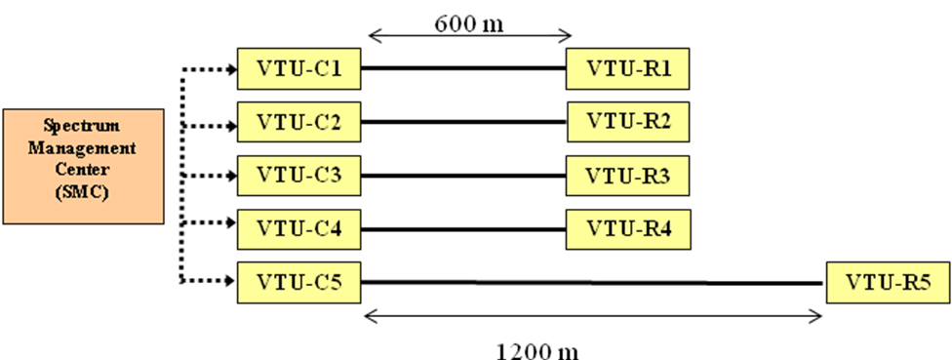
Upstream VDSL2 Configuration
Upstream VDSL has large crosstalk issue
  More coupling at higher frequencies used

Slide 21
Rate Regions for Level 1 and 2
Level 2 often doubles data rates of both long and short lines

Slide 22
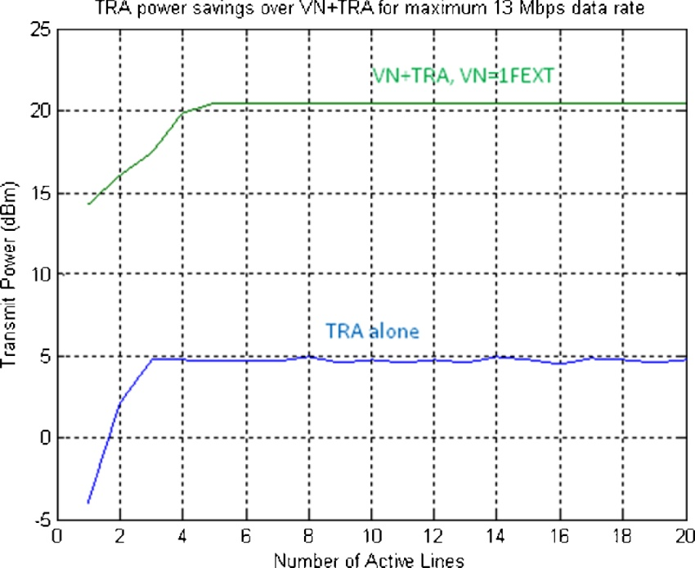
USA and UK DSM Standards/Reports on L2
Both Recommend Tiered Rate Adaption (TRA)
Both reviewed and recommend AGAINST use of Virtual Noise
This curve is Figure 7 from UK NICC (Ofcom) standards group’s UK DSM Report
  US conclusions similar
By analogy – Wireless systems equivalent would be “pretend other users always on,”
which would lead to significant loss in number of users served.
Notes:
Lowering VN to less than the level on crosstalker will just move the upper line down -
One FEXT cross talker is what ALU has used in their marketing and in discussions in the EU etc.

Slide 23
DSM Levels
DSM Level | First Availability | Speeds (Mbps) | Description
1 | 2007 | <25-50 | Function: Single-line Data and Single-Line Control Goal: Line Stability: reduce retrains and packet errors Standard: ITU – G.997.1, G.992.1,5 (ADSL1, ADSL2+, VDSL2)
2 | 2010 | <100 | Function: Multiline Data Collect, Single-Line Control Goal: Power control and savings Standard: ITU – G.997.1, G.992.1,5 (ADSL1, ADSL2+, VDSL2)
3 | 2013 | 100+ | Function: Multiline Data and Control (VECTORED) Goal: Cancel Noises and Crosstalk (100+ Mbps) Standard: ITU, G.vector (VDSL3)

Slide 24
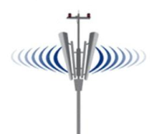
Vectored DSLs
Like “MIMO” in wireless
Proposed, patented, Stanford 2001
ITU G.993.5 standard (2009)
  A component of DSM Level 3
Vectored
DSLAM
Old DSLAM
Port 1
CPE 1
Customer 1
crosstalk
Customer 2
“wireless”
Old DSLAM
Port 2
CPE 2
0

Slide 25
Vectored VDSL FTTN (Downstream)
Bonding+Vectoring
Vectoring - 1 pair
North America
Residential
Europe
Residential
Single-pair,
No vectoring
100-pair Telco cable, 4x25-pair binders (NIPP-NAI model)
Does not include Telco cross-box, so gains may be larger!

Slide 26
But is that all? (NO)
Crosstalk noise
NoiseB
Noise A
Noise C
Noise
floor
Vectoring does not cancel A,B,C
because they are not at transmit
Antenna location (only at receiver)
Crosstalk removal “exposes” other noises
  Back to stability (DSM Level 1)
  Instability in USA field teststo 75-85% of vectored lines become unstable
    Up from 15-20% today

Slide 27
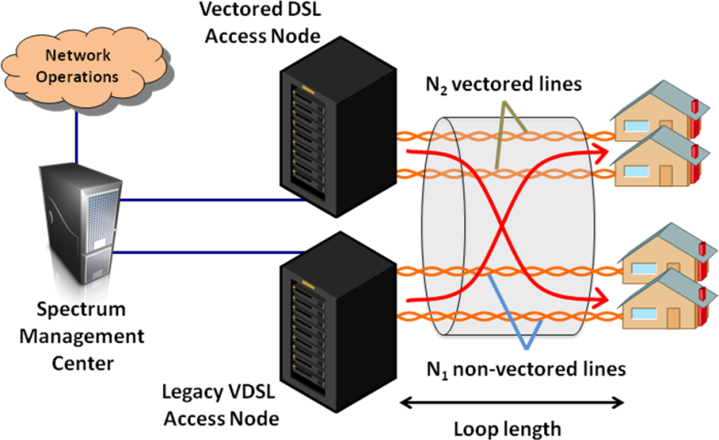
Downstream VDSL Mixture
Vectoring cancels only FEXT among the N₂ lines

Slide 28
Mixed Binder Rate Region

Slide 29
Bonded and vectored DSLs
Use 2 lines at receiver
  Roughly doubles the data rate for bonding
  But allows one of noise A, B, or C to be removed so even more than 2x,
    But which to remove? (DSM)
Vectored
DSLAM
Multi-line
CPE 1
Customer 1
crosstalk
rcvr
Customer1
rcvr
“wireless”
-
-
0
Noises A, B, and C

Slide 30

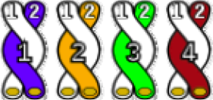
G(iga)DSL?
(use of phantoms, 4GBB)
7
6
5
4
3
2
1
0
Recognizes that vectoring enables the use of “phantoms” or split pairs
  Can eliminate crosstalk (vectoring) and up to 6 other noise sources simultaneously
Invented by ASSIA Inc (2003)
  Patents already issued
  World Telecommunications Conference (WTC/ISSLS), Edinburgh 2004

Slide 31
4-Pairs? (Gigabit @ 500m)
Symmetric Data Rate vs Cable Length for 4 twisted pairs as a MIMO Channel
2
35 MHz band plan, 21 dBm aggregate power (US and DS combined), -150 to -140 dBm/Hz linear noise increase, Coding gain 6 dB
Bit cap = 20
1.5
Data Rate in Gbps
1
0.5
0
100
200
300
400
500
600
700
800
900
1000
Cable Length in meters

Slide 32


Copper PON? (Cu-PON or PCN)
LT
VDSL3
200 pair, 200 customers (so no extra copper at LT)
LT
VDSL3
Homes have “party” lines (same as passive split in PONs)
  Requires dispatch to “pedestal” or “drop” point
  Up to 4 pairs in “higher-revenue neighborhoods” – sometimes called “G.fast”
1 Gbps shared over 2-4 customers
  Can use same “dynamic bandwidth assignment” as GPON or EPON
  Higher data rate per user by 10x

Slide 33
DSL (with DSM) Rate Reach Steps
Mbps
Range-Planning Tool
  Error (+/- 15%)
2:1 Asymmetry ratio (Down/Up) on speeds above 20 Mbps

Slide 34
The Broadband Path Forward
Leverages reasonable cost-effective steps with existing copper
  Each step increasing available bandwidth in timely fashion
  Requires very high-speed and accurate management
    Most of which is not in the equipment
Allows broadband investment to match customer demand as it increases
    Increases for IPTV or video to more customers
    Increases for wireless smaller-cell or network offload
    Timely manner – no step requires large infrastructure rebuilding
Level 1
X € value
Level 2
3X value
Level 2
10X value

